Slide 1
SEAM CARVING
Content Aware Resizing

Slide 2
ABOUT OUR TEAM
16521102: NGUYỄN HỮU THẮNG
16520783: VŨ TRẦN THÀNH NAM
162521548: GIẢNG PHÚC VINH

Slide 3
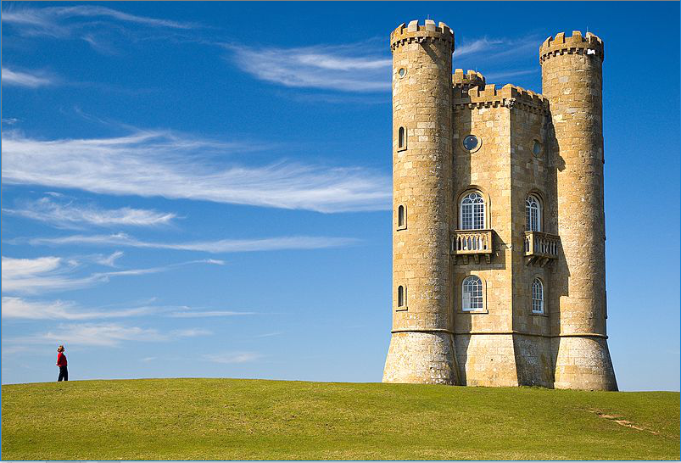
HOW CAN WE RESIZE AN IMAGE AND KEEP ITS CONTENT NATURAL?

Slide 4
CROP?
ORIGIN
CROPPED
Sure, it lost so much content.
We need another method!

Slide 5
SO WE NEED SEAMCARVING ALGORITHM!

Slide 6
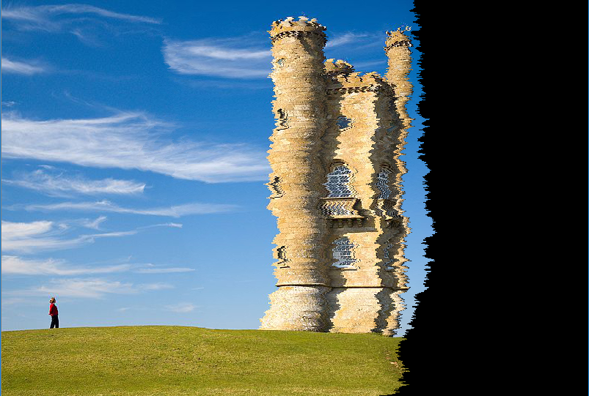
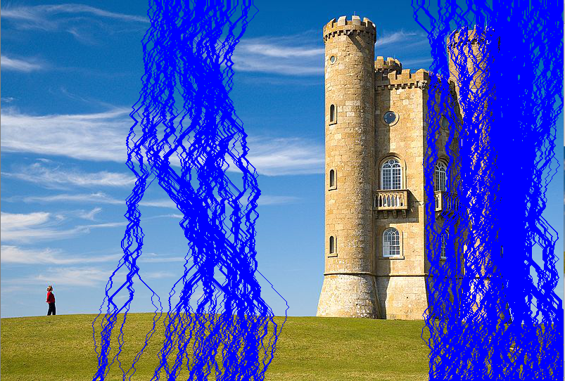
REMOVING PIXELS WITH THE LOWEST ENERGY?

Slide 7
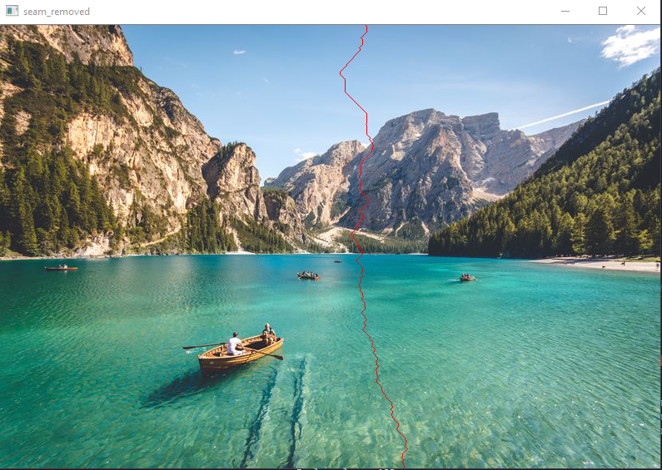
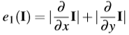
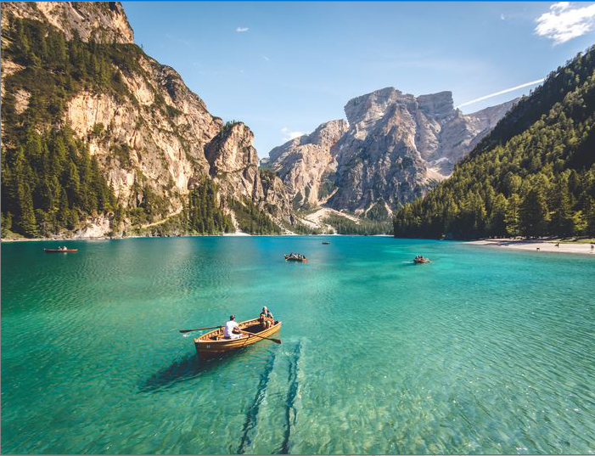
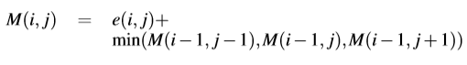
IMAGE RESIZED BY VERTICAL SEAMS
Energy Function
Cumulative Minimum Energy M

Slide 8
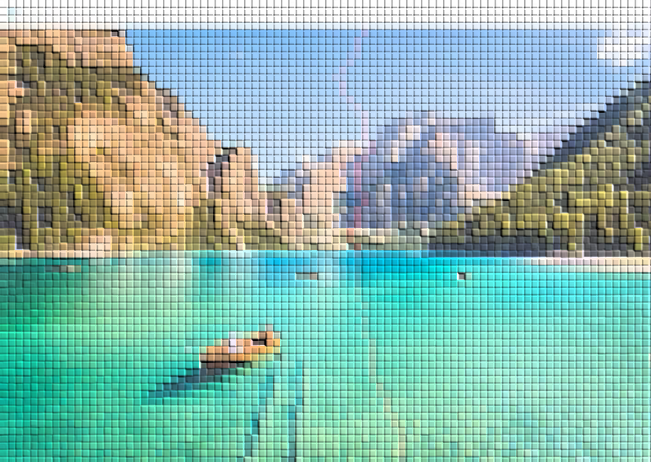
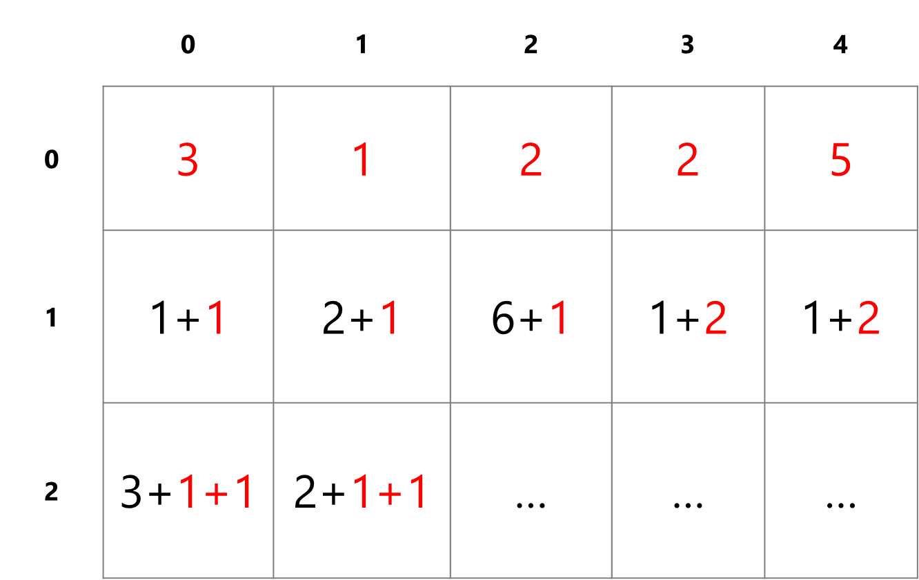
Cumulative Minimum Energy M

Slide 9
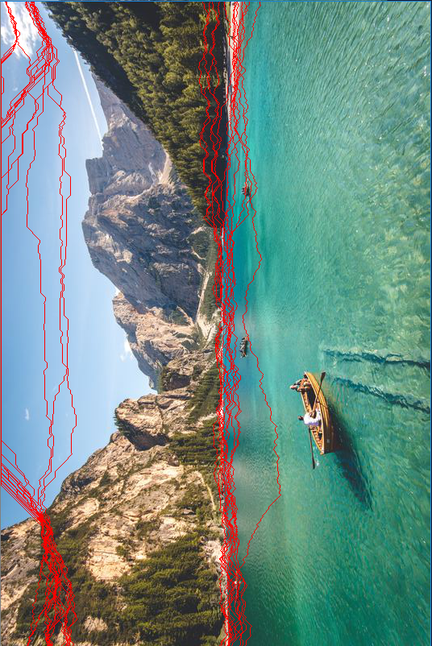
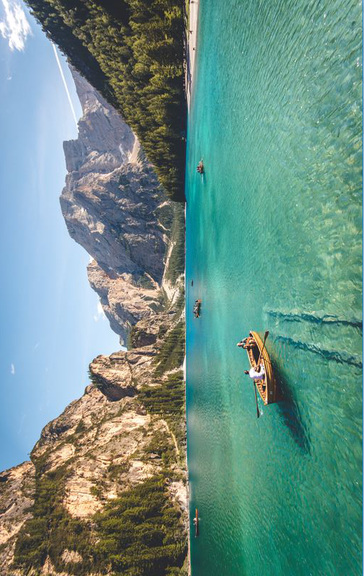
IMAGE RESIZED BY HORIZONAL SEAMS
We just need to rotate the image 90 degree and resize it by vertical seams

Slide 10
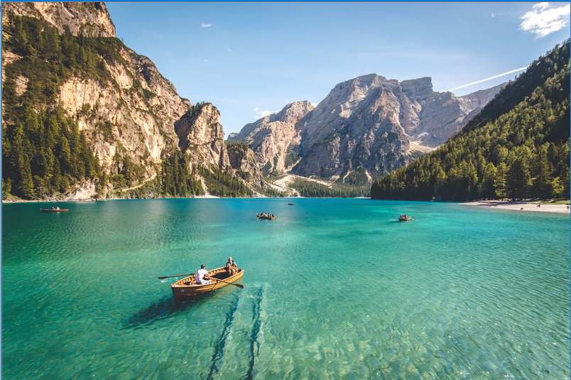
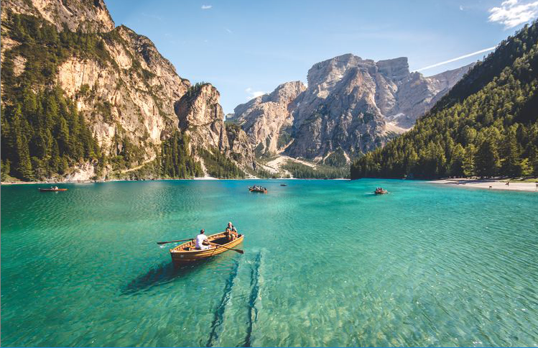
COMINE VERTICAL AND HORIZON WE GOT:

Slide 11
REFERENCE: Seam Carving for Content-Aware Image Resizing
Shai Avidan Mitsubishi Electric Research Labs Ariel Shamir The Interdisciplinary Center & MERL

Slide 12
"SUCCESS IS WALKING FROM FAILURE TO FAILURE WITH NO LOSS OF ENTHUSIASM.”
WINSTON CHURCHILL

